Slide 1
PROJECT ON USER ANALYTICS IN THE TELECOMMUNICATION INDUSTRY -- OVERVIEW
NAME: S. SUJANA KUMARI AFFILIATION: DIGICROME ACADEMY

Slide 2
PROJECT OVERVIEW
Project Scenario:
We are working for a wealthy investor that specializes in purchasing assets that are undervalued. This investor’s due diligence on all purchases includes a detailed analysis of the data that underlies the business, to try to understand the fundamentals of the business and especially to identify opportunities to drive profitability by changing the focus of which products or services are being offered.
Project Description:
The employer wants us to provide a report to analyze opportunities for growth and make a recommendation on whether TellCo is worth buying or selling. We will do this by analyzing a telecommunication dataset that contains useful information about the customers & their activities on the network. We will deliver insights you managed to extract to your employer through an easy-to-use web-based dashboard and a written report.

Slide 3
DATA DESCRIPTION
SOURCE OF MOBILE DATA: The data used for the analysis is provided by Next Hikes.
FEATURES/VARIABLES INCLUDED: There are around 55 features and variables included in the data. The most common and important variables include Experience Score, Engagement Score and Satisfaction Score etc.
DATA SIZE AND FORMAT: The data has around 150001 rows and 55 columns in the form of csv.
NECESSARY LIBRARIES TO BE IMPORTED: Jupyter notebook and VS Code
import pandas as pd
import numpy as np
import matplotlib.pyplot as plt
import seaborn as sns
from sklearn.model_selection import train_test_split
from sklearn.ensemble import RandomForestRegressor
from xgboost import XGBRegressor
from sklearn.metrics import mean_absolute_error, mean_squared_error, r2_score

Slide 4
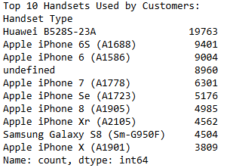
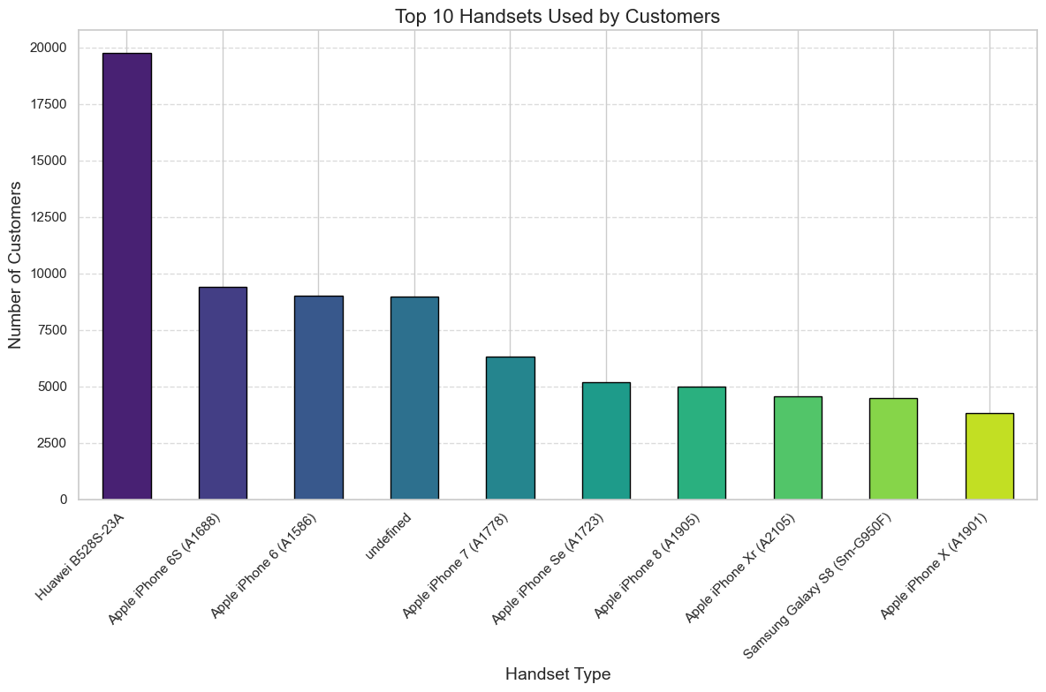
TASK 1- USER OVERVIEW ANALYSIS
To Identify the Top 10 Handsets Used by Customers:
Interpretation:
Top Handsets and Manufacturers:
Huawei B528S-23A leads as the most popular handset, with a significant margin over other models.
Apple dominates the market with a variety of iPhone models, collectively representing the majority of top handsets.
Samsung holds a strong presence with notable models like the Galaxy S8 and A5, though less dominant than Apple.

Slide 5
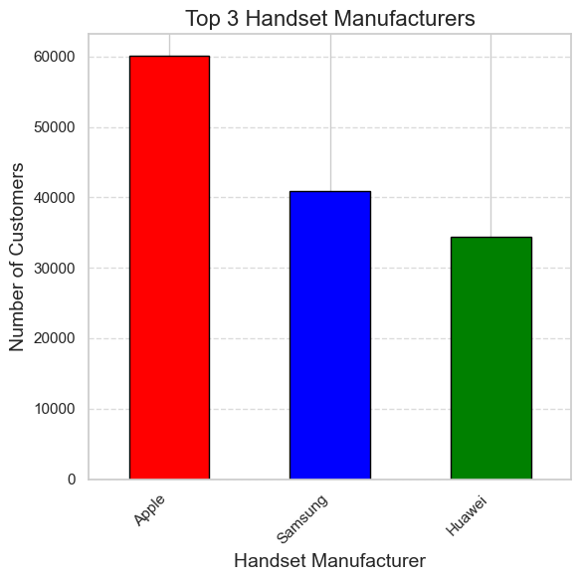
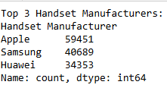
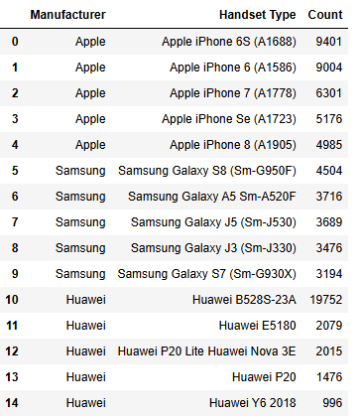
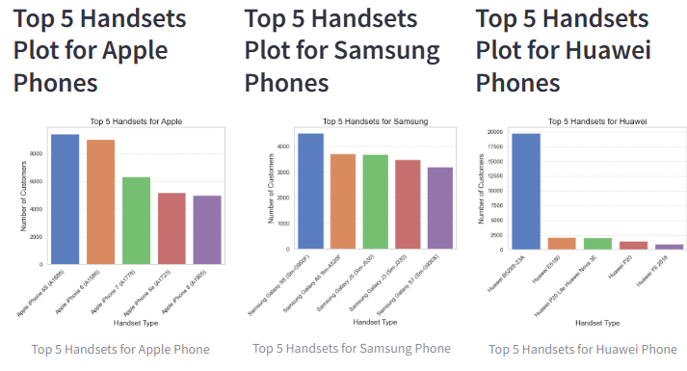
TASK 1- USER OVERVIEW ANALYSIS
To Identify the Top 3 Handset Manufacturers
Identify the Top 5 Handsets per
Top 3 Handset Manufacturer

Slide 6
TASK 1- USER OVERVIEW ANALYSIS
INTERPRETATION AND RECOMMENDATION BASED ON HANDSET DATA:
Interpretation:
1. Top Handsets and Manufacturers:
Huawei B528S-23A leads as the most popular handset, with a significant margin over other models.
Apple dominates the market with a variety of iPhone models, collectively representing the majority of top handsets.
Samsung holds a strong presence with notable models like the Galaxy S8 and A5, though less dominant than Apple.
2. Manufacturer Breakdown:
Apple is the most prevalent manufacturer, followed by Samsung and Huawei. This indicates a high preference for Apple devices among customers.
Huawei's leading handset is significantly more popular than its other models.
3. Brand-Specific Insights:
Apple's top models are mainly older versions, which may reflect customer satisfaction with these devices or slower upgrade cycles. Samsung and Huawei users also favor specific models, with Samsung users showing interest in various Galaxy series and Huawei users favoring the B528S-23A.

Slide 7
TASK 1- USER OVERVIEW ANALYSIS
Recommendations to Marketing Teams:
1. Focus on Apple Device Users:
Strategy: Tailor marketing campaigns to target Apple device users, considering their high engagement and loyalty.
Action: Promote Apple-specific offers, such as accessories or app bundles, and consider partnerships with Apple-related services to enhance customer experience.
2. Highlight Top Handsets:
Strategy: Since Huawei B528S-23A is highly popular, create targeted promotions or loyalty programs focused on users of this and similar handsets.
Action: Develop exclusive deals or bundles for users of the top handsets to encourage continued engagement and brand loyalty.

Slide 8
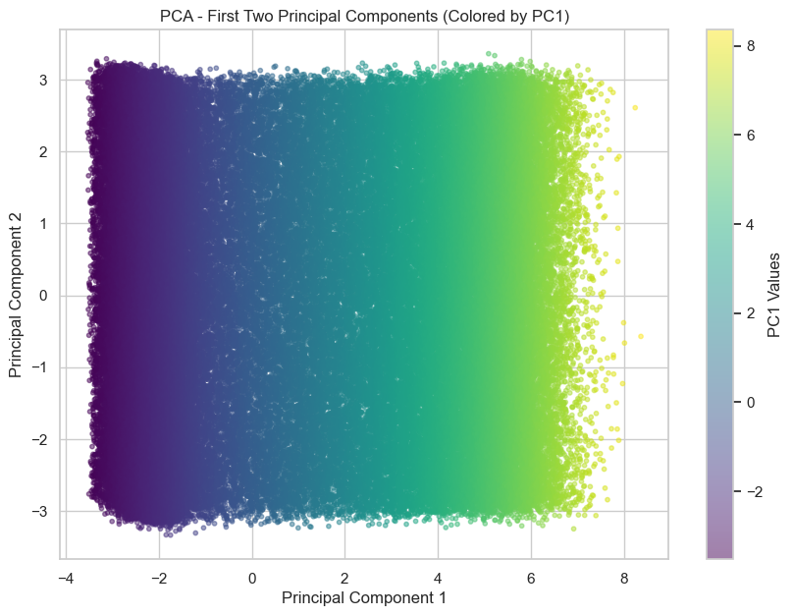
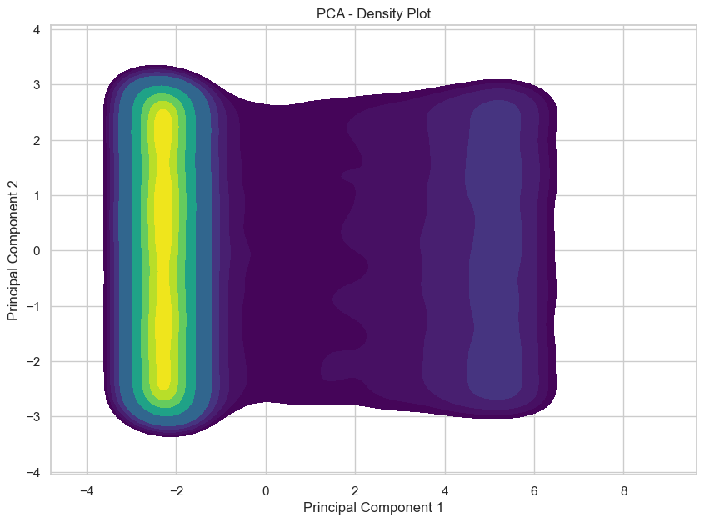
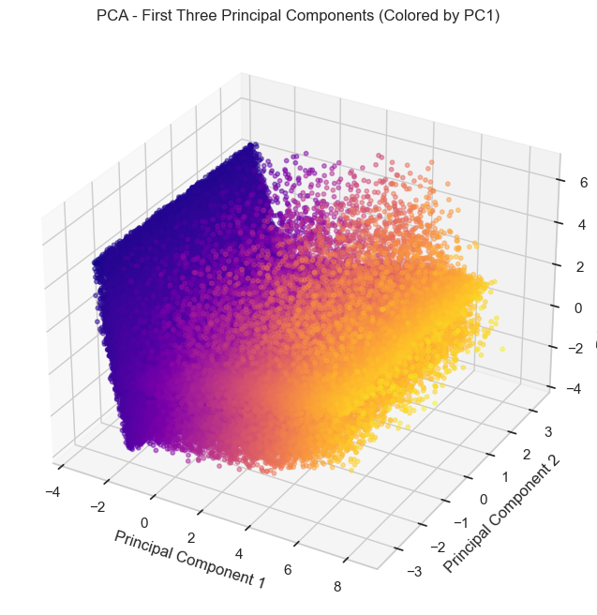
DIMENSIONALITY REDUCTION
Interpretation:
Significant Information Captured: The first two principal components capture a substantial portion of the variance in the data, indicating that they are capturing significant patterns in the data.
Dimensionality Reduction: Reducing the data to two principal components has retained a considerable amount of the original information.
Meaningful Interpretation: PC1 and PC2 are likely capturing the most important variations in the data, potentially related to overall data usage patterns, network quality, or device characteristics.
Focus on Main Patterns: Since the first two components explain a significant amount of variance, you can focus on analyzing and interpreting them for your analysis, as they capture the most important relationships in the data.

Slide 9
DIMENSIONALITY REDUCTION
Interpretation of PC1:
PC1 seems to represent the overall network performance and data usage intensity. Users with higher values on PC1 likely have sessions with higher average throughput, longer activity durations, and fewer seconds with low data volumes. They experience less time with very low download and upload throughputs.
Interpretation of PC2:
PC2 seems to represent the dominance of download volume in a session. Higher values on PC2 indicate sessions with a greater amount of data downloaded (especially for non-gaming applications).
In Summary:
PC1: Reflects the general network performance and data usage intensity during a session. PC2: Represents the volume of data downloaded, particularly for non-gaming applications.

Slide 10
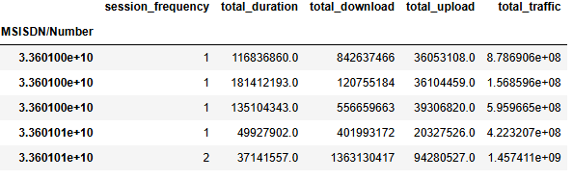
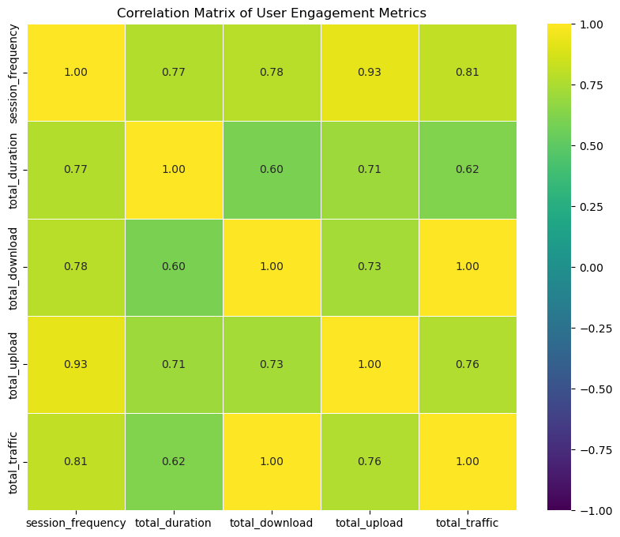
TASK--2 USER ENGAGEMENT ANALYSIS
ENGAGEMENT METRICS
Interpretation of Correlation Matrix:
High correlations (close to 1) suggest strong linear relationships. For example, session_frequency has a very high correlation with total_upload (0.93) and a high correlation with total_traffic (0.81).
Moderate correlations indicate moderate relationships between variables, such as total_duration and total_download (0.60).
The correlation between total_download and total_traffic is extremely high (0.99), indicating a near-perfect linear relationship, likely because total traffic is the sum of total download and upload.
These correlations can help identify key relationships between user engagement metrics, guiding further analysis or decision-making.

Slide 11
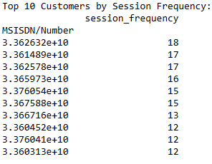
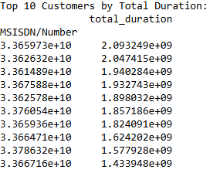
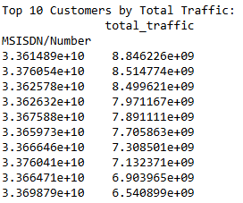
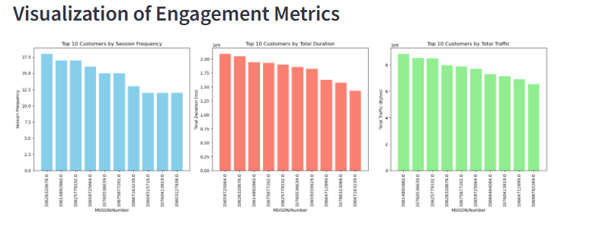
TASK 2- USER ENGAGEMENT METRICS
Top 10 customers per engagement metric
Interpretation of TOP 10 Customers using engagement metrics
Some MSISDNs appear in multiple top lists, indicating that they are significant users in terms of frequency, duration, and total traffic.
High session frequency does not always equate to high total duration or traffic, and vice versa. This suggests that user behavior can vary widely.
These insights can guide targeted marketing, customer support, and optimization of services based on user engagement metrics.

Slide 12
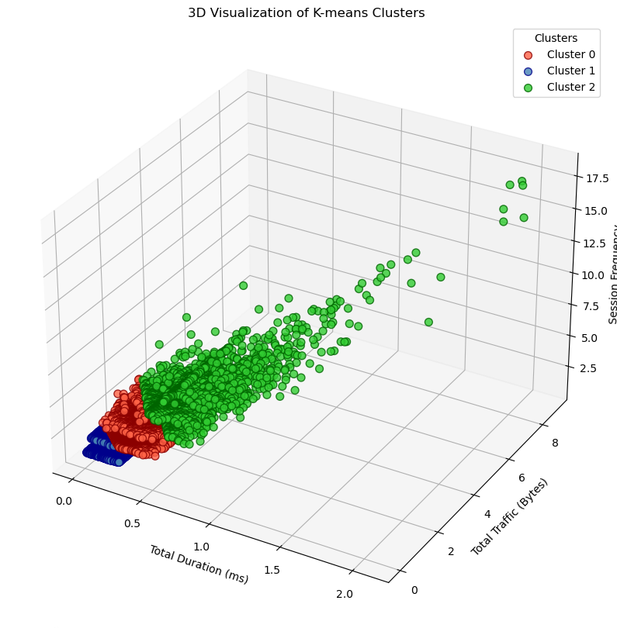
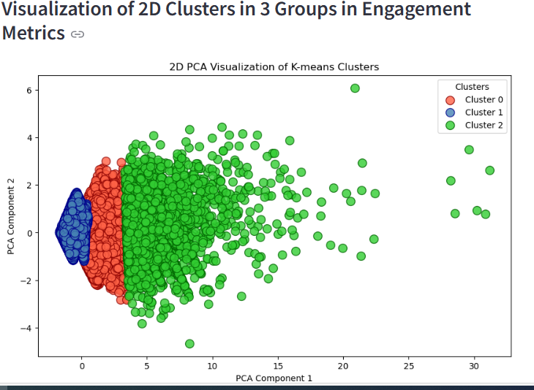
ENGAGEMENT METRICS CLUSTERING
Interpretation of K-3 means clustering both by 2D and 3D
Cluster 0: Likely represents users with moderate engagement frequency and high total usage. These users may have substantial data consumption over a range of session frequencies.
Cluster 1: Characterized by less frequent but high total usage. This cluster might represent users with occasional intense usage or high data consumption in fewer sessions.
*Cluster 2: Represents highly active users with both high session frequencies and high data usage. These users are very engaged, using large amounts of data frequently.

Slide 13
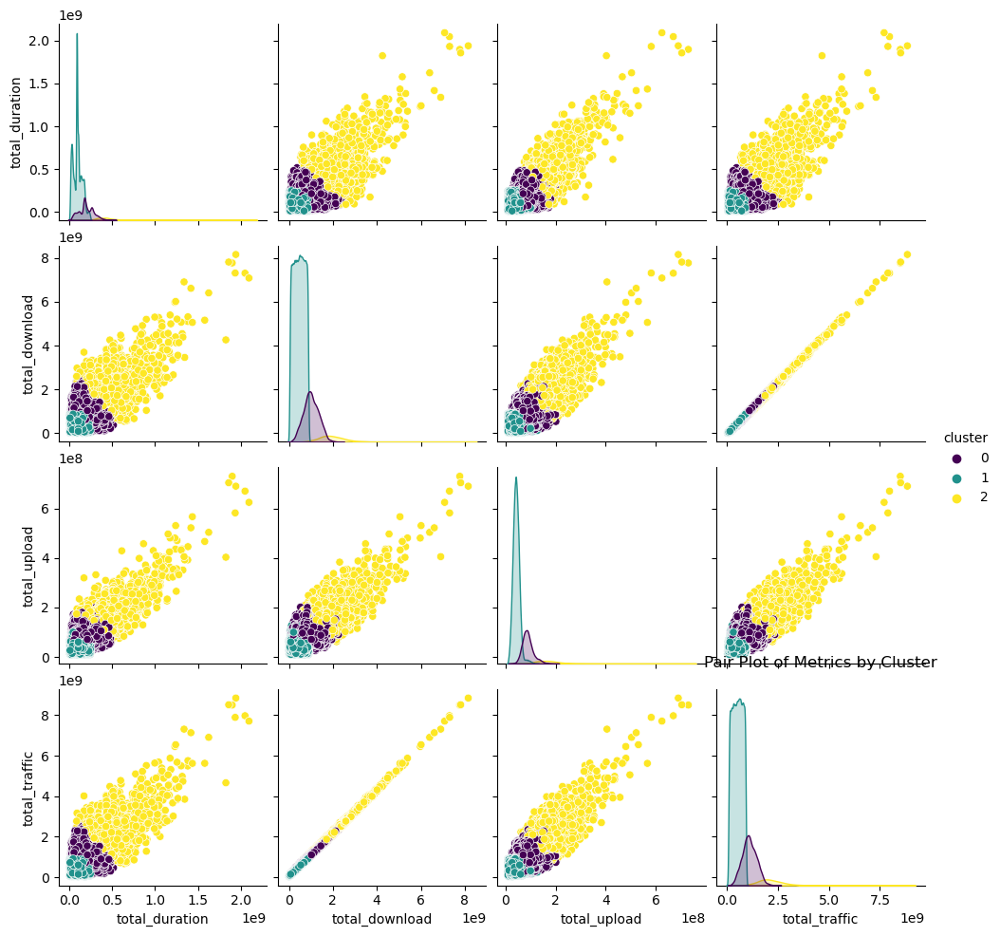
ENGAGEMENT METRICS CLUSTERING
● Compute the minimum, maximum, average & total non-normalized metrics for each cluster. Interpret your results visually with accompanying text explaining your findings.

Slide 14
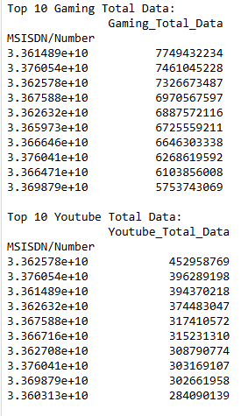
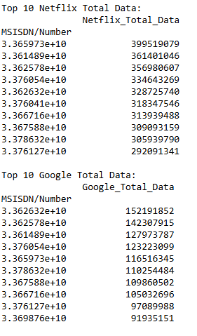
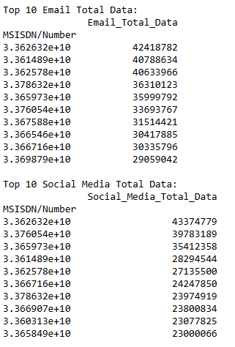
USER ENGAGEMENT METRICS
● Aggregate user total traffic per application and derive the top 10 most engaged users per application¶

Slide 15
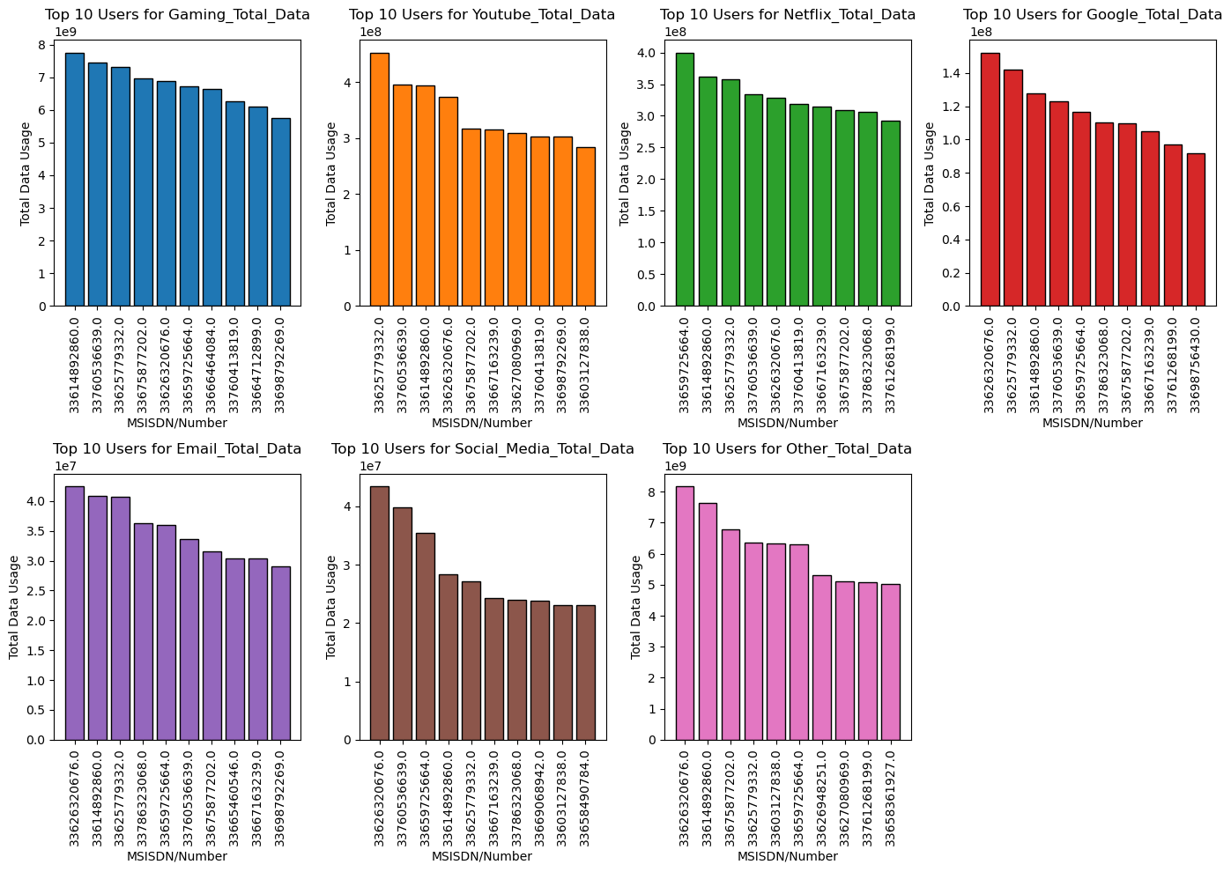
METHODOLOGY
General Observations of the top 10 most engaged users per application:
Heavy Users: The data indicates that the same users are consistently appearing across multiple categories, showing a trend of general heavy data usage.
Gaming vs. Streaming: Gaming requires the most data, followed by "Other" activities and then streaming services like YouTube and Netflix. This reflects the data-intensive nature of modern gaming and the increasing popularity of streaming services.
Impact: Understanding these usage patterns can help in designing more efficient networks and tailored user experiences, potentially leading to more satisfied customers and optimized service delivery.

Slide 16
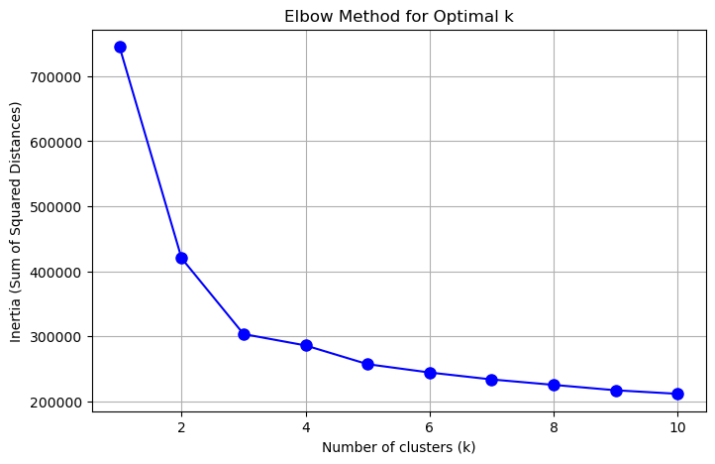
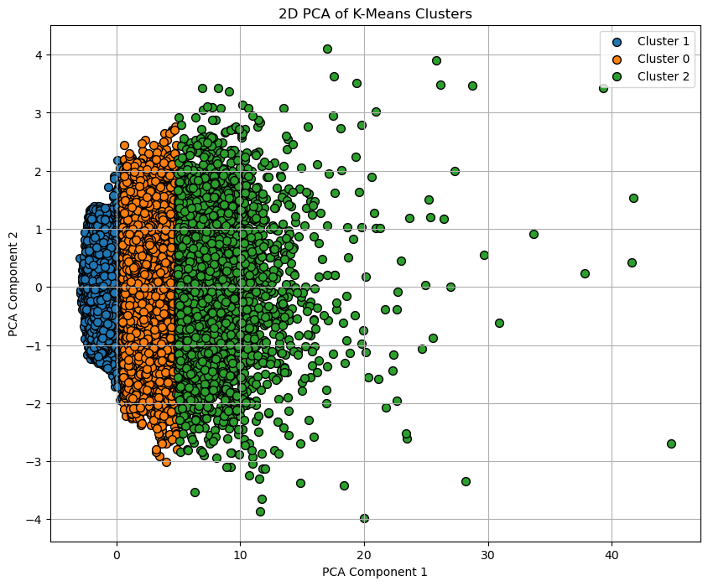
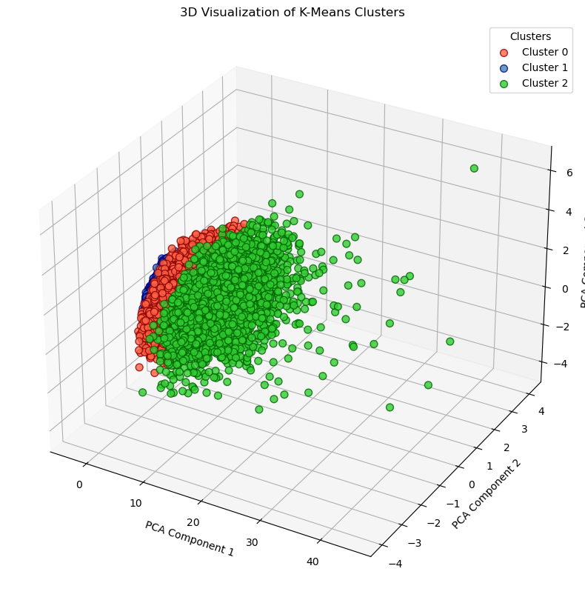
APP DATA K MEANS CLUSTERING

Slide 17
K MEANS CLUSTERING APP DATA
Interpretation of Application k- means cluster by optimal k method both 2D and 3D
Based on the provided 3D visualization, the K-Means clustering algorithm appears to have effectively grouped the applications into three distinct clusters.
Key Observations:
Cluster Separation: The clusters are visually well-separated, suggesting that the algorithm has successfully identified meaningful groupings within the data.
Cluster Density: Cluster 0 and Cluster 2 appear to have higher densities of data points, indicating that there might be more applications in these clusters. Cluster 1 seems to have a lower density.
Cluster Distribution: The clusters are distributed in different regions of the 3D space, suggesting that they are defined by distinct combinations of the PCA components.

Slide 18
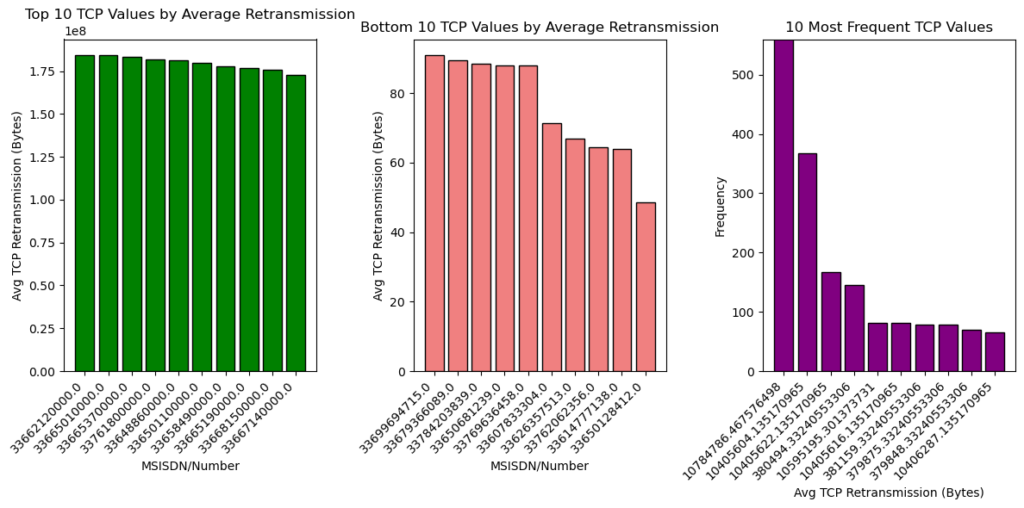
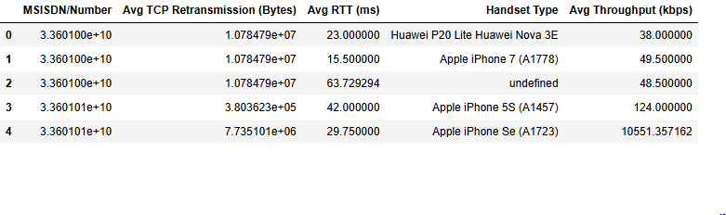
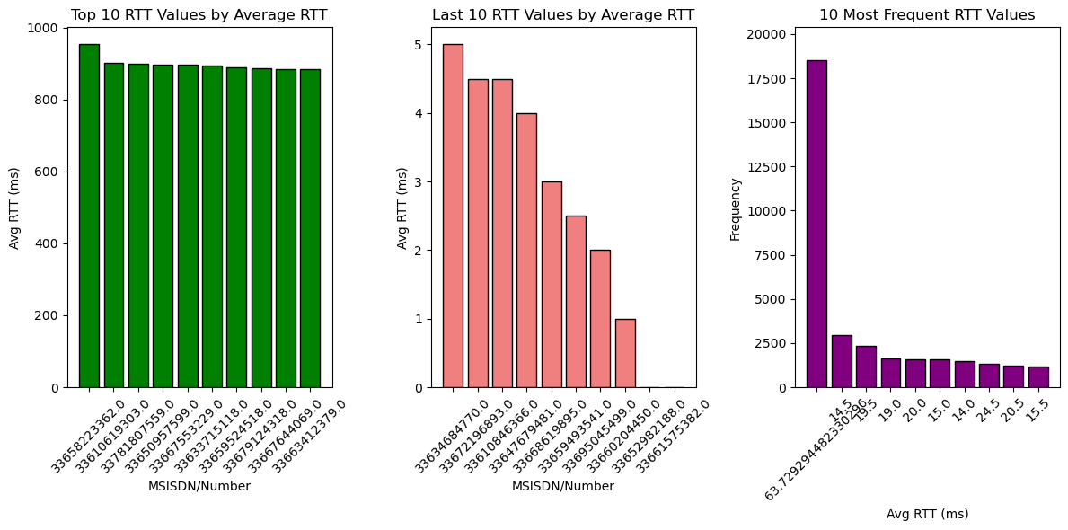
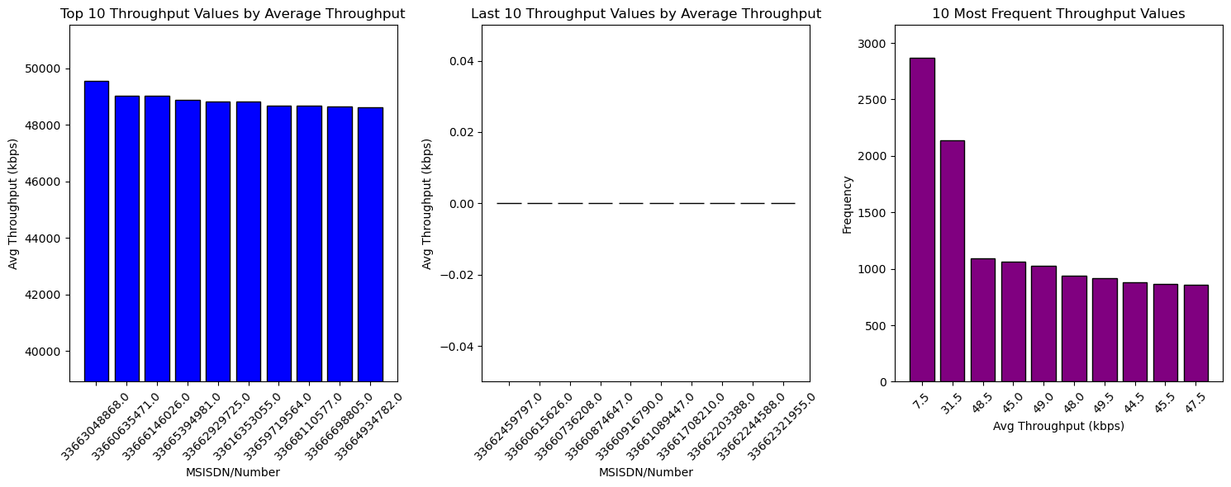
EXPERIENCE ANALYTICS
Aggregate, per customer, the following information: Average TCP retransmission, Average RTT, Handset type, Average throughput, Top 10, Bottom 10 and most frequent.

Slide 19
EXPERIENCE ANALYTICS
The distribution of the average throughput per handset type and provide interpretation for your findings.
Interpretation of Average Throughput per Handset Type
Top Performers: Handsets like the Zyxel Communicat. Sbg3600 and A-Link Telecom I. Cubot Power offer the highest throughput, which is beneficial for users requiring high-speed internet access, such as for streaming or large data downloads.
Moderate Performers: Devices like the A-Link Telecom I. Cubot Nova and Zyxel Communicat. Lte7460 show good throughput but may not provide the highest speeds available.
Low Performers: Devices like the A-Link Telecom I. Cubot Note Plus and Zyxel Communicat. Zyxel Wah7706 have lower throughput, which could be a limitation for users who need faster internet speeds.
The average TCP retransmission view per handset type and provide interpretation for your findings.¶
¶Interpretation of Average TCP Retransmission per Handset Type
High Retransmission Devices: Devices like Zyxel Communicat. Sbg3600 and Lte7460 exhibit extremely high retransmissions, which could be a result of poor signal quality, interference, or network congestion.
Moderate Retransmission Devices: Devices such as the A-Link Telecom I. Cubot Note S and A5 are in the moderate range, indicating some issues that could be addressed with better network configurations or hardware improvements.
Low Retransmission Devices: Devices like A-Link Telecom I. Cubot Power and Nova show minimal retransmission activity, suggesting a good connection quality and fewer issues related to network loss.

Slide 20
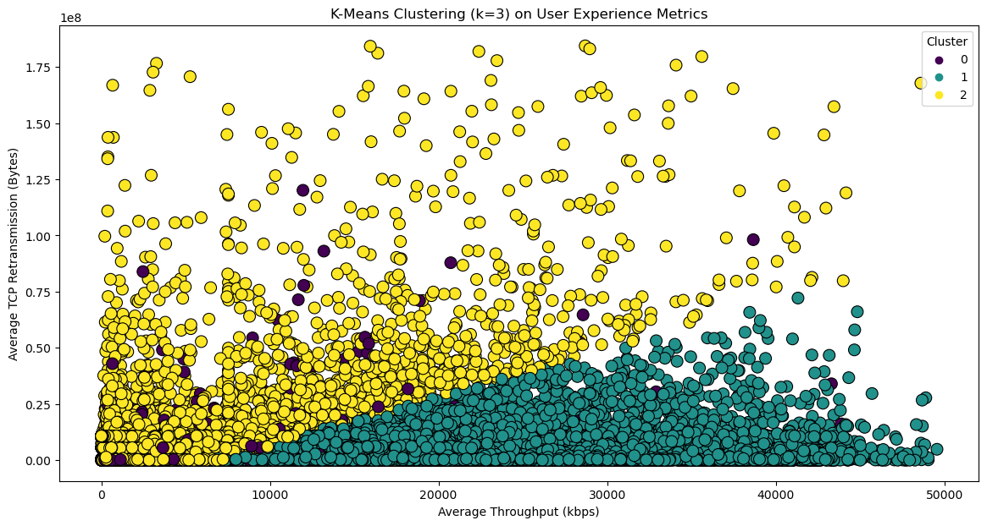
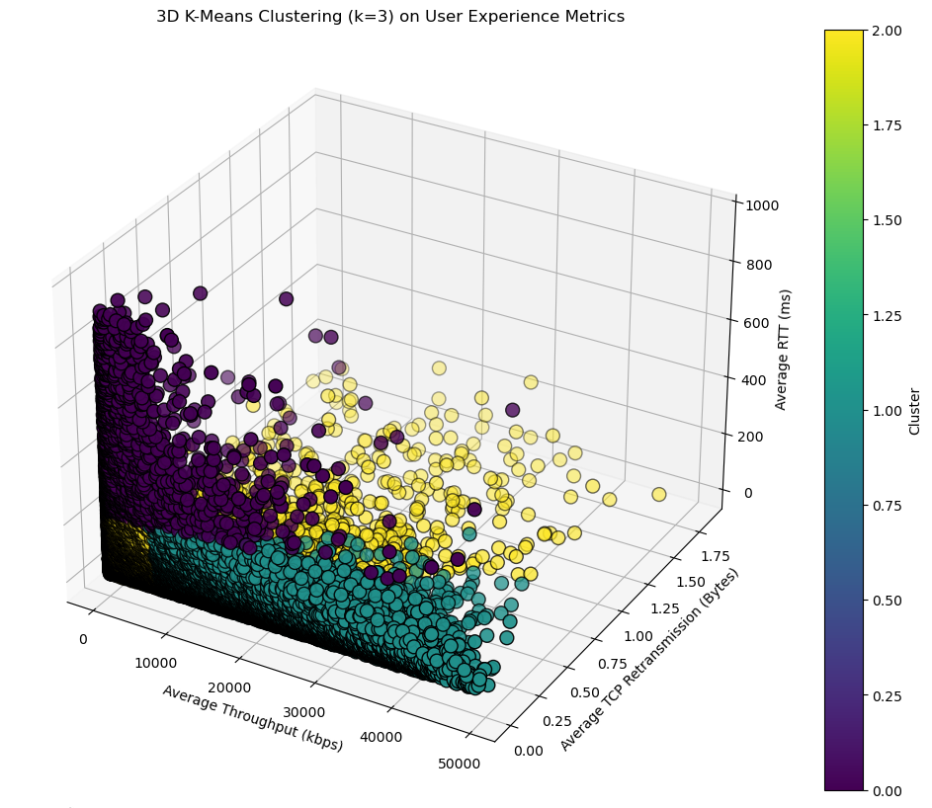
EXPERIENCE ANALYTICS
K-MEANS CLUSTERING BASED ON EXPERIENCE ANALYSIS: Interpretation:
Cluster 0 (Yellow): These users have a great internet connection! They can download and upload files quickly, and their connection is very reliable.
Cluster 1 (Teal): These users have a slower internet connection. It might take longer to load websites or download files. They might also experience interruptions or disconnections.
Cluster 2 (Purple): These users have a connection that's somewhere in between. Sometimes it's good, and sometimes it's not so good.

Slide 21
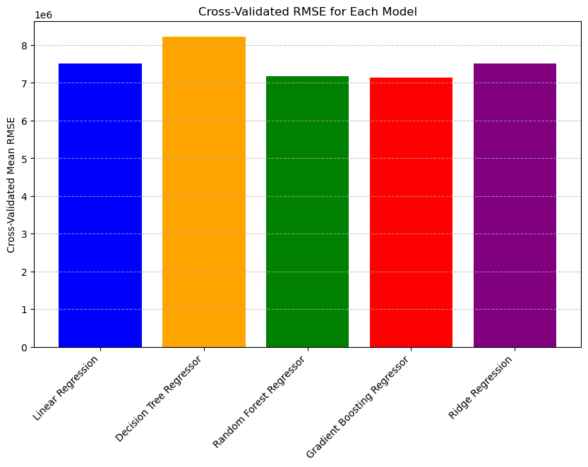
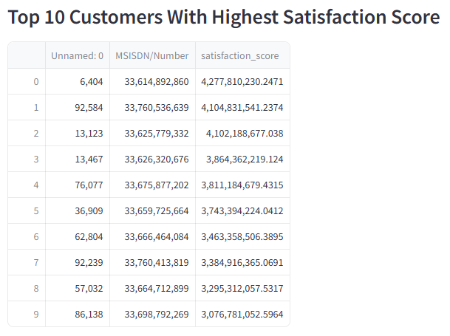
SATISFACTION ANALYSIS
Consider the average of both engagement & experience scores as the satisfaction score & report the top 10 satisfied customer
Build a regression model of your choice to
predict the satisfaction score of a customer and consider best fit model.
Best Fit:
Based on the metrics, Random Forest seems to offer the best fit due to its combination of low error rates and robust generalization, making it the most reliable model for predicting the satisfaction score in this context.

Slide 22
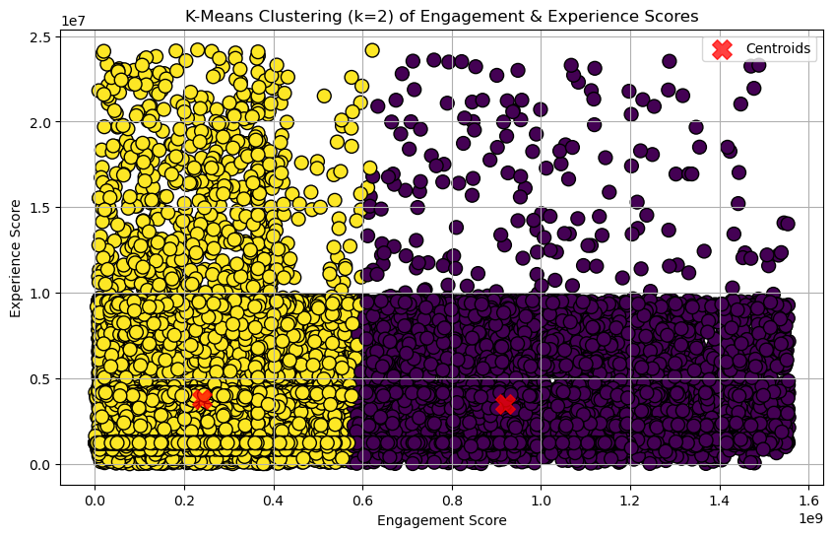
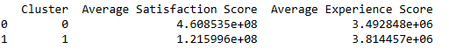
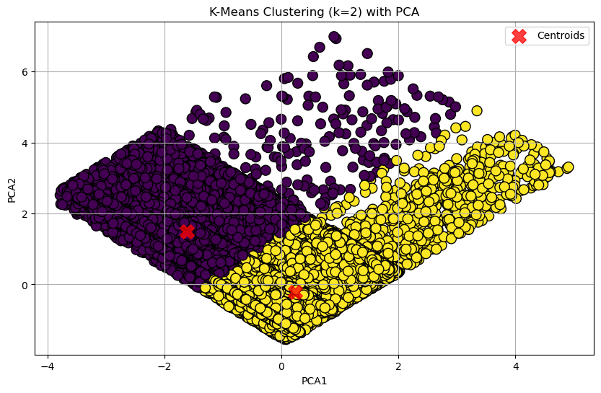
SATISFACTION ANALYSIS
k-means (k=2) on the engagement & the experience score.
Analysis
Satisfaction Scores:
Cluster 0 has a significantly higher average satisfaction score compared to Cluster 1. This suggests that the customers in Cluster 0 are, on average, much more satisfied than those in Cluster 1.
The large difference in satisfaction scores might indicate that Cluster 0 represents a group of customers who are highly satisfied with the services or products provided, whereas Cluster 1 includes customers with lower satisfaction.
Experience Scores:
The average experience scores are somewhat similar between the two clusters, with Cluster 1 having a slightly higher average experience score compared to Cluster 0.

Slide 23
FINAL CONCLUSION
Interpretation
Cluster 0 has a significantly higher Average Satisfaction Score compared to Cluster 1. This suggests that customers in Cluster 0 are generally more satisfied with their experience. Cluster 1 has a slightly higher Average Experience Score than Cluster 0. This indicates that while the overall satisfaction is lower, the experience score is marginally better.
Decision Making
Based on these scores, here are some considerations for your employer:
Customer Satisfaction:
The high satisfaction score in Cluster 0 is a positive indicator. It suggests that a significant portion of the customer base is very satisfied, which is a good sign for customer retention and loyalty.
Customer Experience:
The experience scores are relatively close, with Cluster 1 having a slight edge. This indicates that the overall customer experience is fairly consistent across clusters, though there is room for improvement in satisfaction for Cluster 1.
Recommendation
Given the high satisfaction score in Cluster 0 and the relatively consistent experience scores, it seems that the company has a strong base of satisfied customers. However, the lower satisfaction in Cluster 1 suggests there are areas that need attention.
Recommendation: Proceed with the purchase, but with a strategy to improve customer satisfaction in Cluster 1. This could involve targeted improvements in customer service, product quality, or other areas impacting satisfaction.

Slide 24
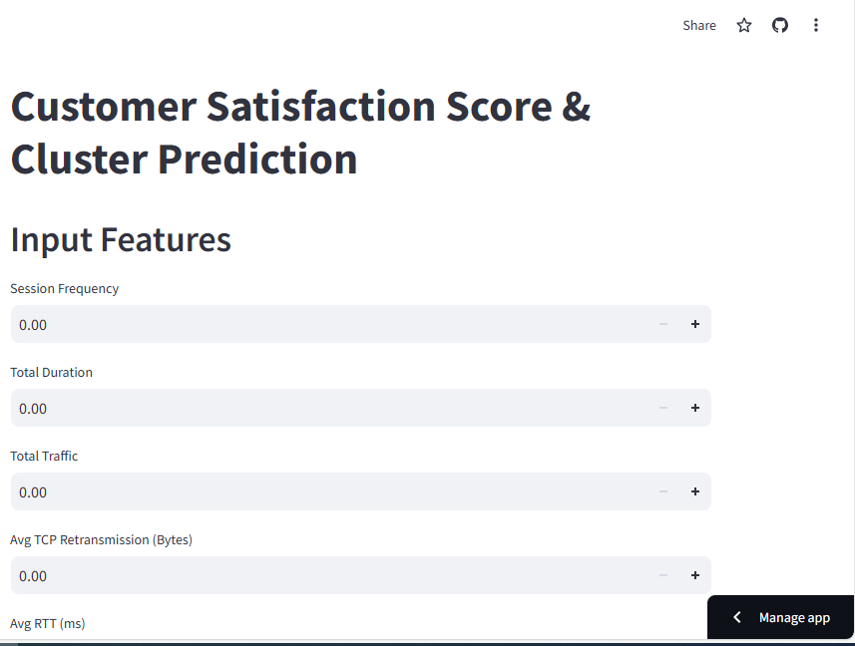
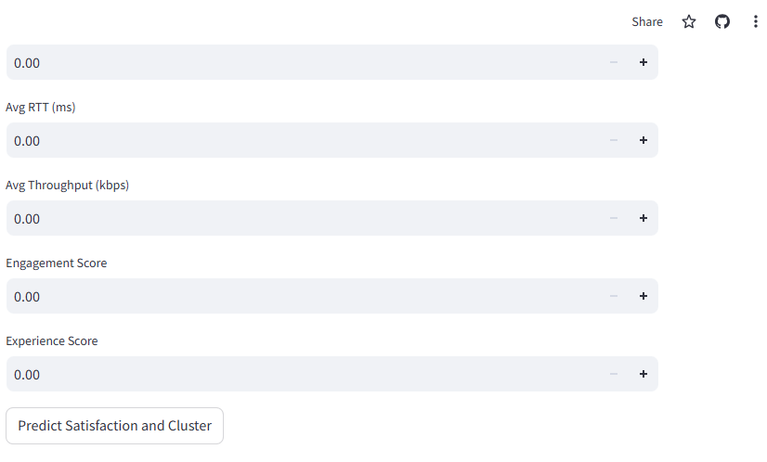
FINAL OUTPUT AFTER DEPLOYMENT
I

Slide 25


THANK YOU

